Slide 1
Azure Data Pipeline
Case Study – Solution
Rishi S Mahadevan
Chanchal Kumar
Goran Matolia

Slide 2
Step 1: Data Ingestion
Azure Data Factory: Use Azure Data Factory (ADF) as the primary data ingestion tool to gather data from various sources, such as on-premises databases, cloud-based storage, and external APIs.
Azure Event Hub / Azure IoT Hub: For real-time data ingestion (e.g., sales events, customer interactions), Azure Event Hub or IoT Hub can be used to capture and stream data into the pipeline.
Blob Storage / ADLS Gen2: Store raw ingested data temporarily in Azure Blob Storage or Azure Data Lake Storage (ADLS) Gen2, which can serve as a data lake.

Slide 3
Step 2: Data Processing
Azure Databricks: This is the core processing engine. Set up Azure Databricks with Spark clusters to:
Clean and preprocess data.
Perform advanced analytics, machine learning, or data transformation tasks.
Prepare data for storage and visualization in a structured and optimized format.
Notebook Orchestration: Use Azure Databricks Notebooks to write ETL (Extract, Transform, Load) scripts and model training.
Data Lakehouse Architecture: Consider structuring the data in a Lakehouse format, using Delta Lake tables in Databricks to combine batch and streaming data for a unified processing approach.

Slide 4
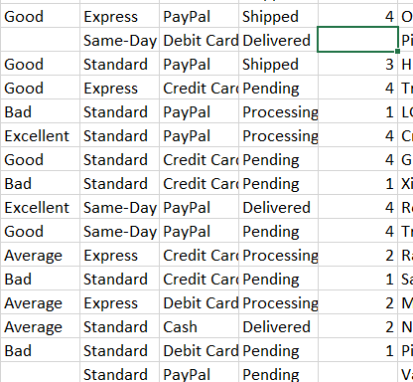
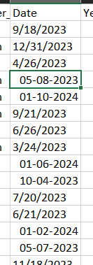
Data Exploration and Findings
302010 rows × 30 columns => Dataset size​
There are a few missing values in a few records.
Date values are of different formats.

Slide 5
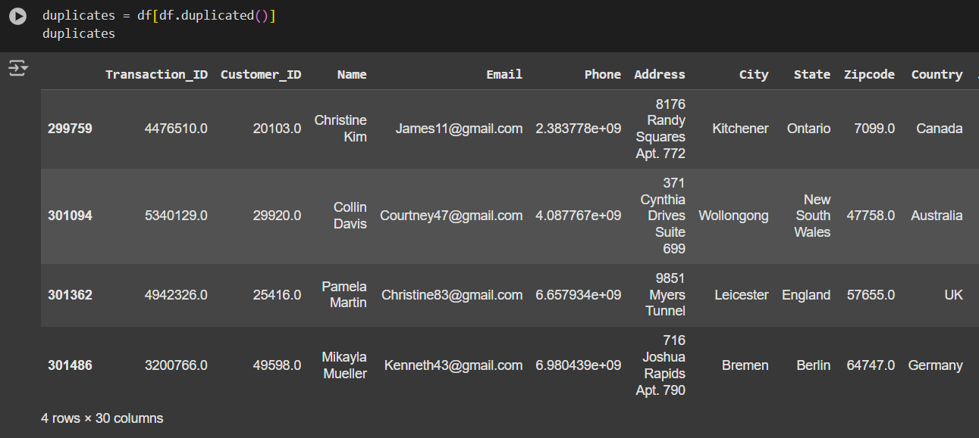
Data Findings
4 Duplicate Rows

Slide 6
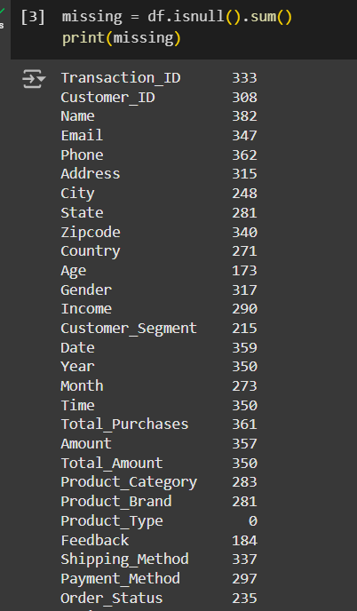
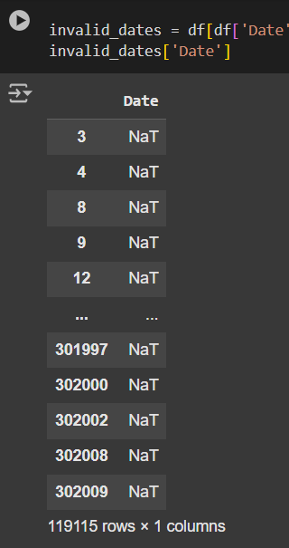
Data Exploration and Findings
<== Missing Values column wise count.
Total 119115 rows have different Date format. ==>

Slide 7
Step 3: Data Storage
Azure Data Lake Storage (ADLS) Gen2: Store curated and transformed data in a structured, hierarchical format. ADLS can serve as the primary repository for processed data.
01
Azure Synapse Analytics / SQL Database: For optimized querying and analysis, move processed data to Azure Synapse Analytics or SQL Database. Synapse Analytics provides powerful analytical capabilities and can serve as a scalable data warehouse.
02
Delta Lake Integration: Use Delta Lake within Databricks for handling transactional updates on large datasets, enabling ACID-compliant storage for reliable data.
03

Slide 8
Step 4: Data Visualisation
Microsoft Power BI Integration: Use Power BI to integrate data across services and enable seamless visualization.
01
Power BI: Connect Power BI to Databricks or Synapse Analytics or the Delta Lake tables in ADLS for data visualization. Power BI can be used to build dashboards that display sales trends, inventory levels, and other KPIs.
Data Sharing: Microsoft provides a unified experience to share insights across departments in TechRetail and support collaborative decision-making.
02
Scheduled Refreshes: Configure Power BI to refresh data from Databricks or Synapse or Delta tables on a schedule, ensuring that dashboards reflect the latest insights.
03

Slide 9
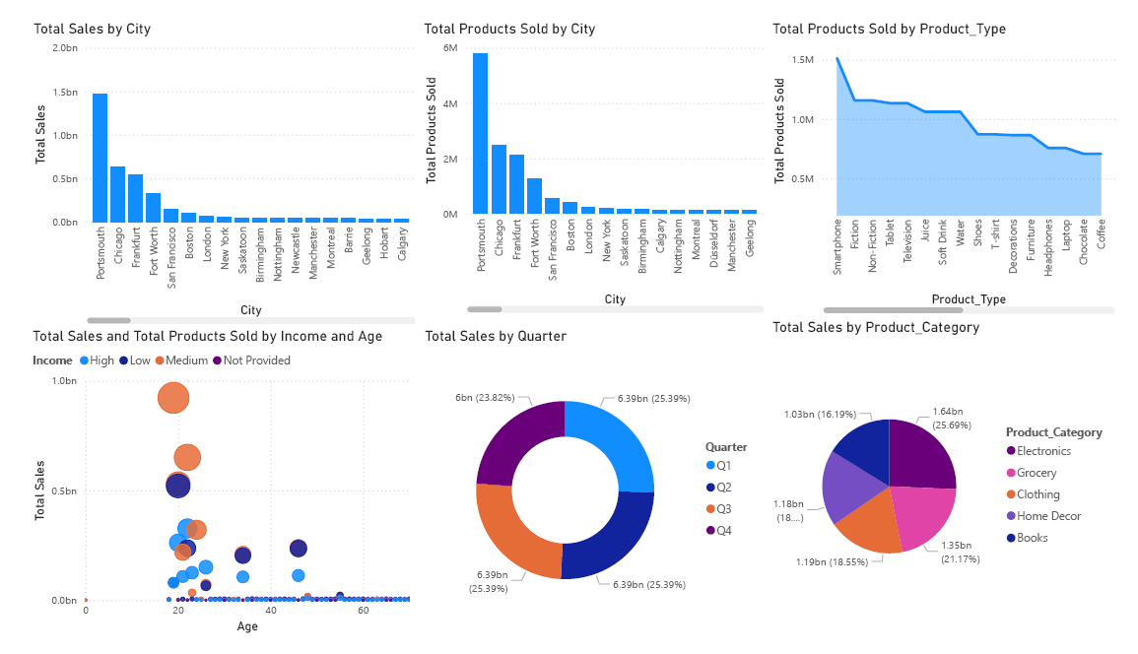
Expected Output after Visualization

